Slide 1
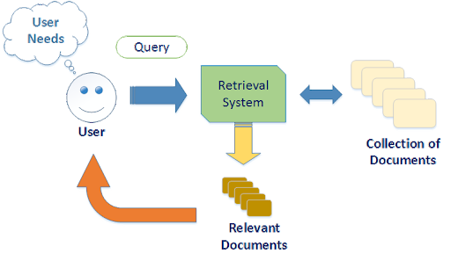
Image and multimedia IR
Anton Zuiev

Slide 2
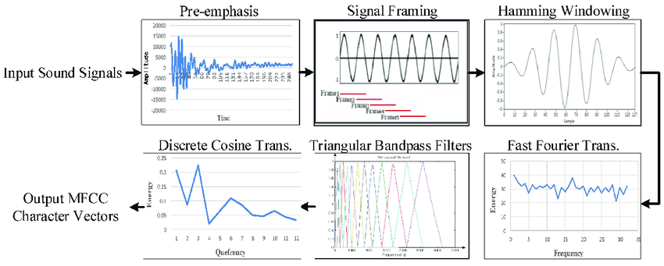
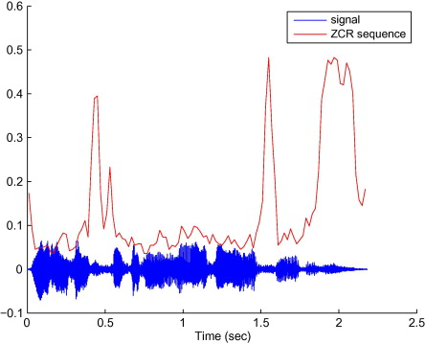
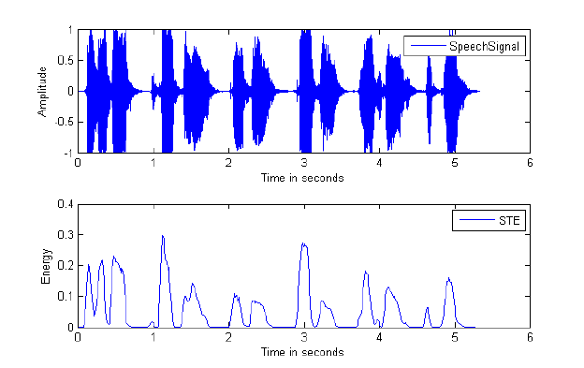
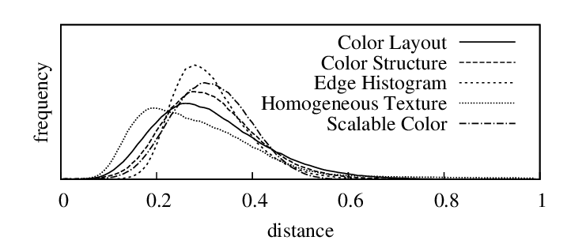
Feature extraction
Summarization of media content.
1.Audio: mel-frequency cepstral coefficients
Zero Crossings Rate,
Short-Time Energy.
2.Visual: color histograms such as the MPEG-7 Scalable Color Descriptor

Slide 3
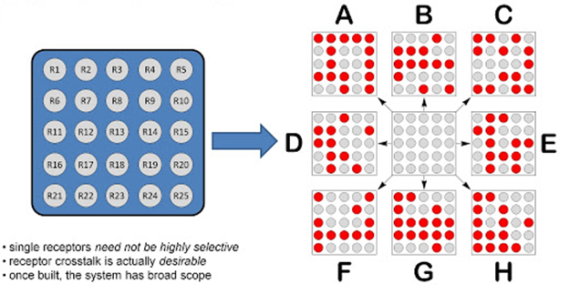
Feature extraction
Detection of patterns by auto-correlation and/or cross-correlation
Patterns are recurring media chunks that can either be detected by comparing chunks over the media dimensions (time, space, etc.) or comparing media chunks to templates (e.g. face templates, phrases).

Slide 4
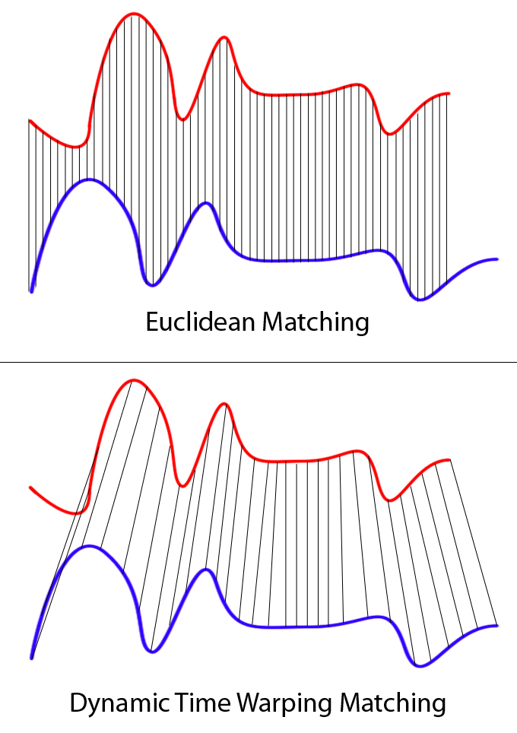
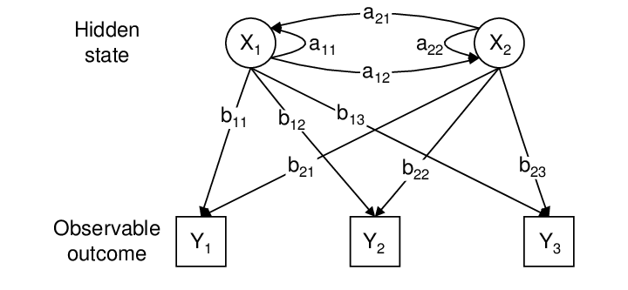
Some categorization methods
Dynamic time warping – is state-of-the-art in gene sequence alignment
Hidden Markov models are state-of-the-art in speech recognition

Slide 5
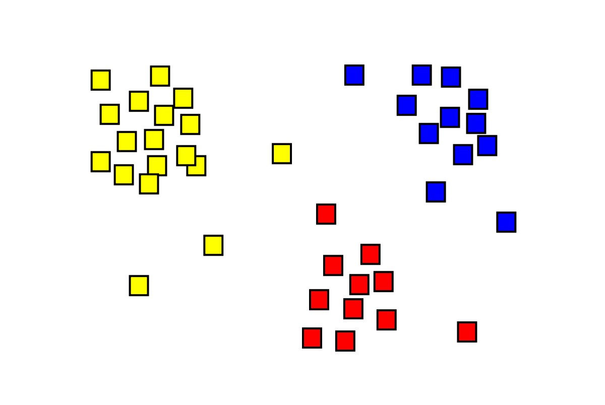
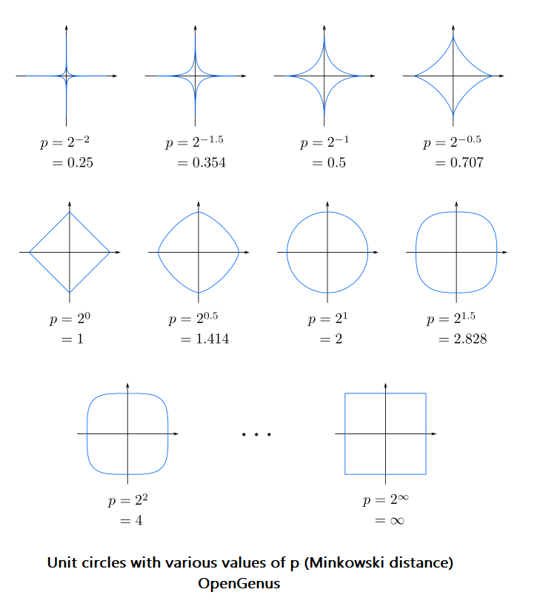
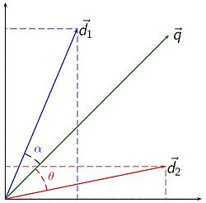
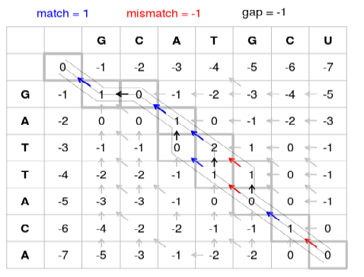
Metric approaches
Cluster analysis
Vector space model
Minkowski distances
Dynamic alignment

Slide 6
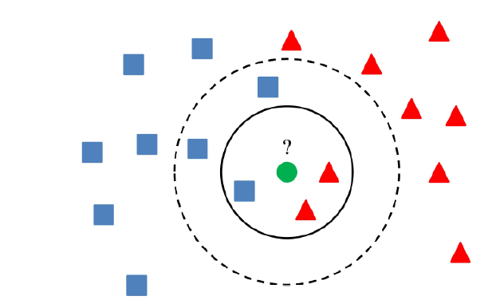
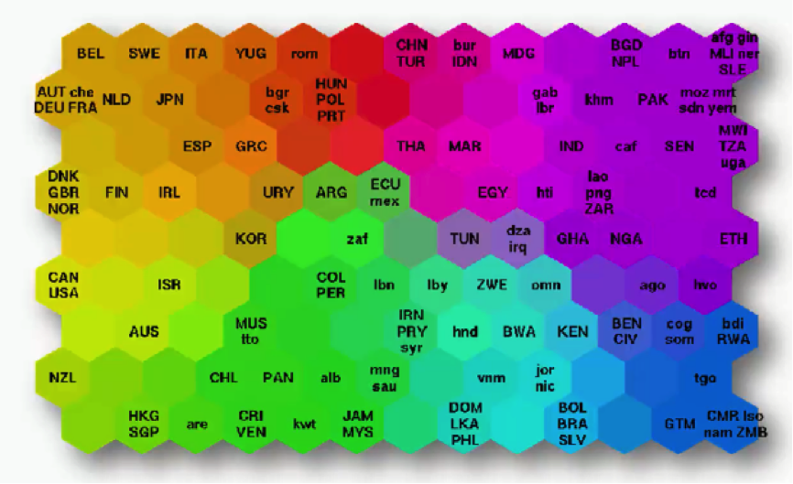
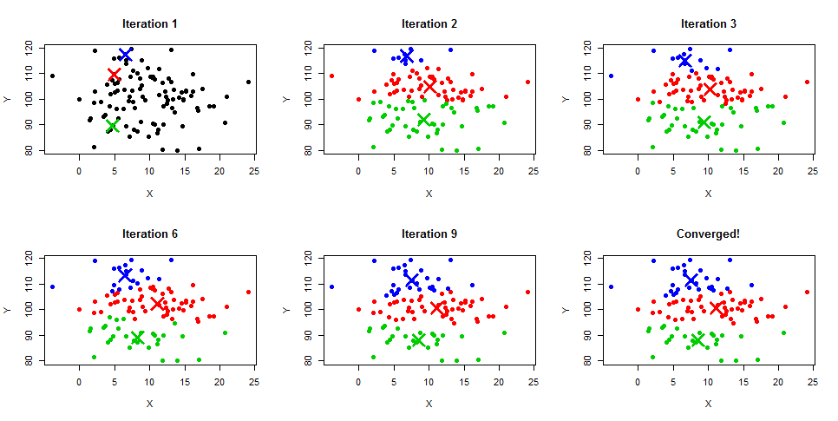
Nearest Neighbor methods
K-nearest neighbors algorithm
K-means
Self-organizing map

Slide 7
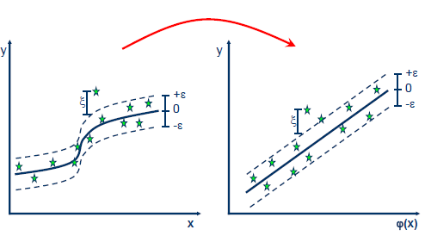
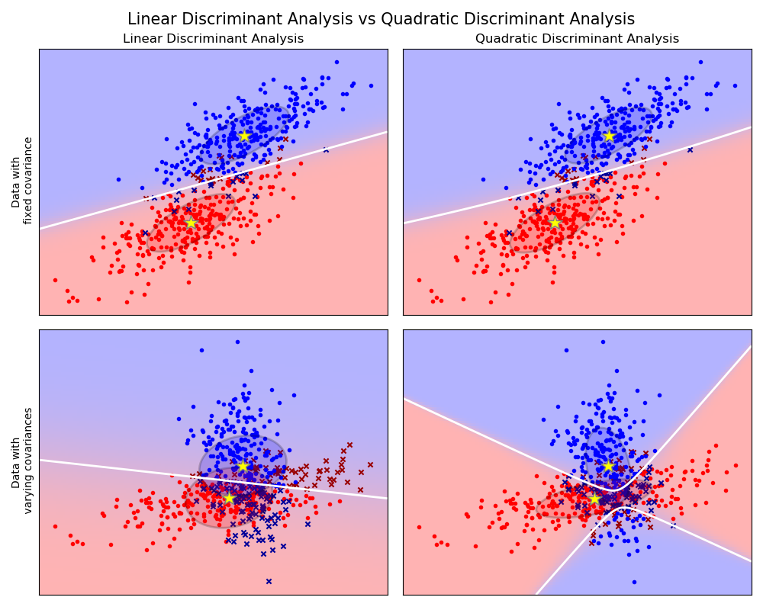
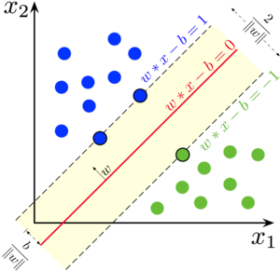
Risk Minimization
Support vector regression
Support vector machine
Linear discriminant analysis

Slide 8
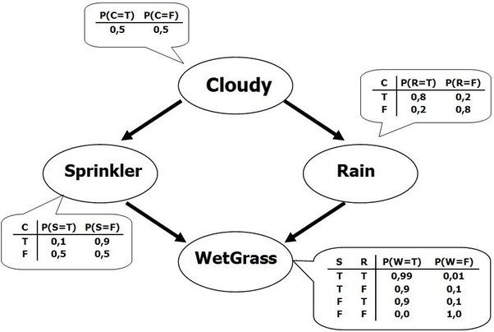
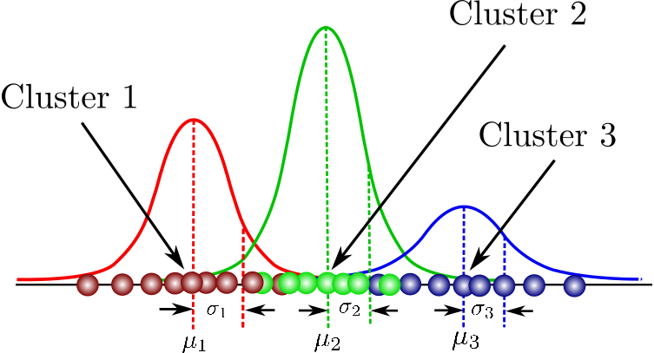
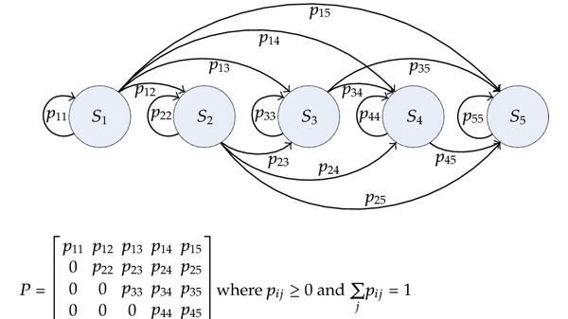
Density-based Methods
Bayes nets
Markov processes
Mixture models

Slide 9
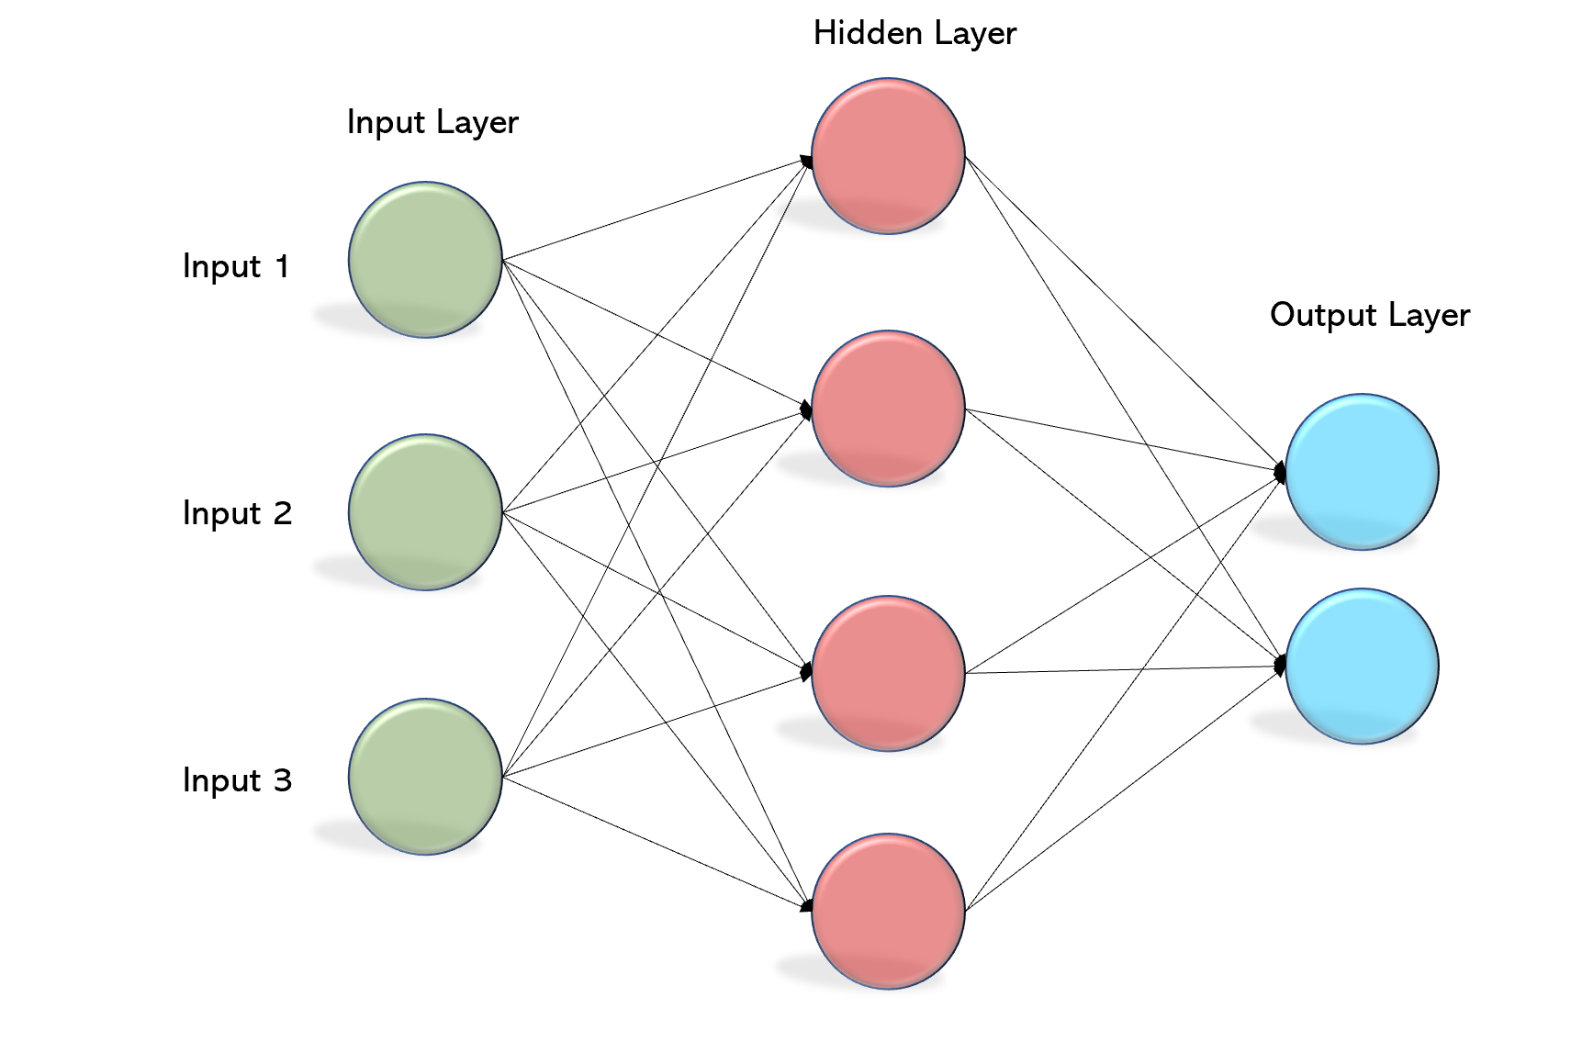
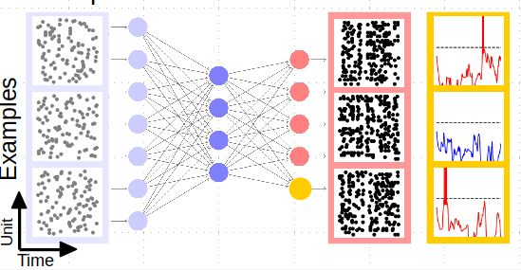
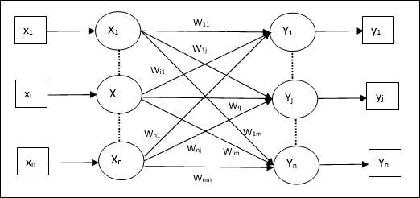
Neural Networks
Perceptron
Associative memories
Spiking nets

Slide 10
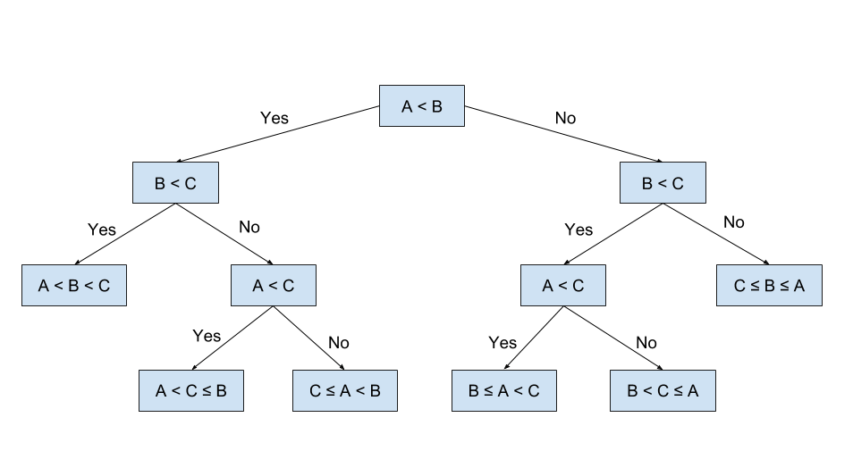
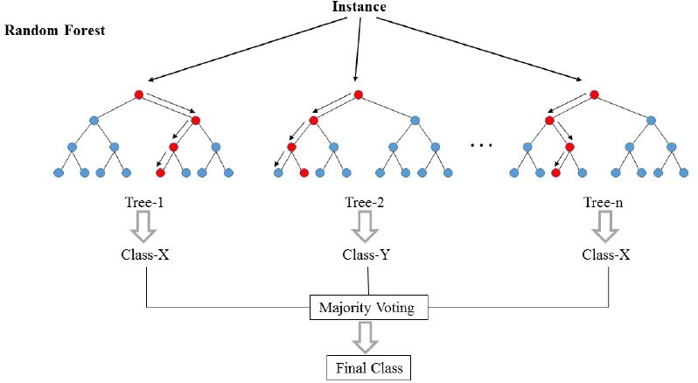
Heuristics
Decision trees
Random forests

Slide 11
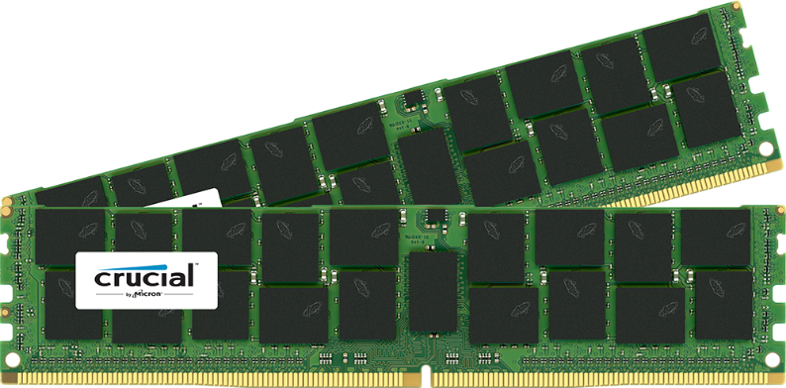

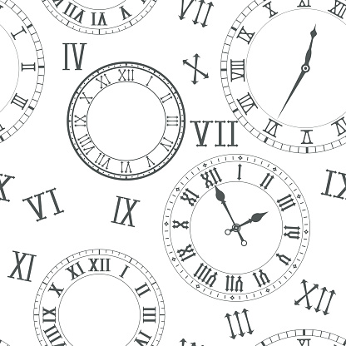

Problems for image and multimedia IR
Best training data
Best feature extraction
Best method
Time-memory-quality exchanges

